Slide 1
Neural Nets with Pytorch
Session 4: Data & Bringing everything together

Slide 2
This workshop
Saving & Loading Models
Writing custom datasets
Train, test, and validation data splits
Practical: bring everything together

Slide 3
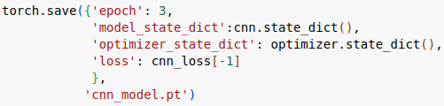

Saving & Loading models
Save training state to resume later
Move models between machines
Save trained model for inference.

Slide 4
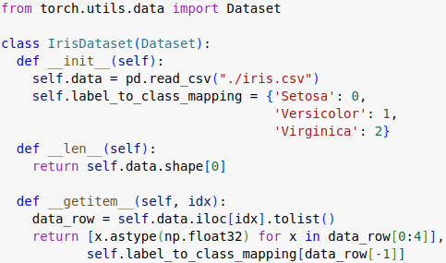
Custom Datasets
Load and use own data

Slide 5

Train, Test, & Validation splits
Training set: data the neural network uses to update weights
Validation set: Check performance of NN on unseen data
Test set: Run once at end of training
Can use PyTorch convenience functions

Slide 6
Practical
Bring together everything so far:
Download CIFAR 10 files
Write a Dataset class, and create train, validation, test sets.
Create your own neural network
Evaluate training, and validation performance
Evaluate test performance.

